Slide 1
Vehicle classification using Yolo

Slide 2
Course Name: Data Mining Lab
Course Code: CSE-476
Intake – 41
Presented To
------------------------------------------------------------------------------------------
Khan Md. Hasib
Assistant Professor
Department of CSE
Bangladesh University of Business and Technology (BUBT)
Email : khanmdhasib@bubt.edu.bd

Slide 3




OUR TEAM
Oleraj Hossin
Ishmoth Ura Nuri
BusHrat Jahan
JOy Adhikary
Nazrul islam
ID: 18192103072
ID: 18192103237
ID: 18192103160
ID: 18192103062
ID: 18192103013

Slide 4
Content
Introduction​
Motivation
Objective
Contribution
Related Works
​Dataset
Challenges
​Future Work

Slide 5
Introduction

Slide 6
Introduction
In every day, People use transportation services to reach their destination place. That’s why road safety and parking area monitoring are essential in regular basis. So Some Agency and company need to collect those data for their business plan. But there are huge Collection of Traffic or Parking area data that are very crucial and difficult to handle manually.
To overcome this situation there are different types of algorithm in Artificial Intelligence to make life easier.

Slide 7
Motivation
Vehicle classification is an important task in various fields. But our main goal is law enforcement and public safety.
Vehicle classification can be used by law enforcement agencies to identify vehicles that may be involved in criminal activity.
Vehicle counting can inform driver that which road is occupied with large number of vehicles and suggest a less busy road to driver.
Vehicle classification can help identify overloading or overweight vehicles that may pose a safety risk on the road.

Slide 8
Objective
Detect or Identify the vehicles type
Counting the Number of vehicles
Inform about the traffic Condition
In and Out Information about vehicles

Slide 9
Contribution
Analyze Existing Paper about Object detection
Research about Yolo Pre-trained Model
Trained and Detect vehicles Using COCO/Darknet Dataset
Implement Yolo-v8 Algorithm to detect Vehicles Types
Deep Sort Implemented for Vehicles counting

Slide 10
Related Works
Literature Review of Existing Paper about vehicle classification.

Slide 11
“An Improved YOLO v2 for Vehecle Detection”
In this paper, by improving YOLO- v2, a model called YOLOv2_Vehicle was proposed for vehicle detection. To obtain better anchor boxes, the vehicle bounding boxes on the training dataset were clustered with k-means clustering, and six anchor boxes with different sizes were selected. Next, the loss function was improved with normalization to decrease the inﬂuence of the different scales of the vehicles.
Based on the experimental results, them YOLOv2_Vehicle could reach 94.78%. In future work, we will collect more actual vehicle data to further study how to improve the accuracy and speed of vehicle detection.

Slide 12
"Vehicle Classification in Video Using Deep Learning”
In this paper, three training data set manually created from two videos in the low video quality category for training the Faster R-CNN and the YOLO deep learning methods Vehicle Classification in Video Using Deep Learning.
Also used AlexNet, a pre-trained convolutional neural network, is used to perform feature extraction which is an integral part of the tracking algorithm aimed at further reducing the errors in track association.

Slide 13
"Vehicle Classification Using Convolutional Neural Networks" by Zhang et al., published in 2018
This research study used YOLOv4 object detection and DeepSORT tracking models to count and classify vehicles into 13 FHWA vehicle classes from video footages from existing roadside cameras. YOLOv4 was also used to detect the presence of rumble strips from roadway images and used to create a rumble strip inventory map. The trained vehicle counting/classification model achieves a counting accuracy of ~97% at daytime and ~91% at nighttime. The rumble strip detection model has ~95% accuracy.

Slide 14
Dataset

Slide 15
Dataset
The COCO (Common Objects in Context) or Darknet or AlexNet dataset is a widely used large-scale image recognition dataset for object detection, segmentation, and captioning tasks. It contains over 330,000 images, each annotated with bounding boxes around the objects in the image, as well as segmentation masks for some objects and captions describing the scene.
Pretrained models trained on the dataset are often used as a starting point for many computer vision tasks. There are several popular deep learning frameworks, such as Yolo, TensorFlow, PyTorch, and MXNet, that provide pretrained models trained on the COCO dataset. These models can be downloaded and used to perform object detection, segmentation, or captioning on new images or videos.

Slide 16
Flow Chart

Slide 17
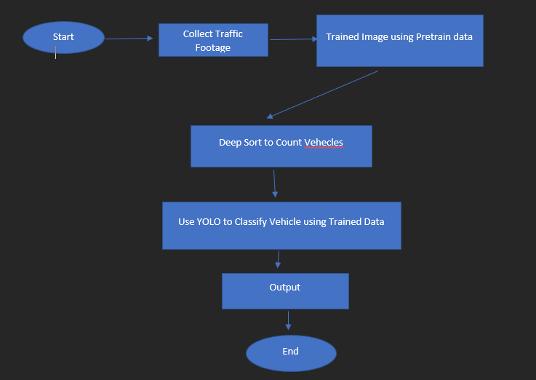
Flow Chart

Slide 18
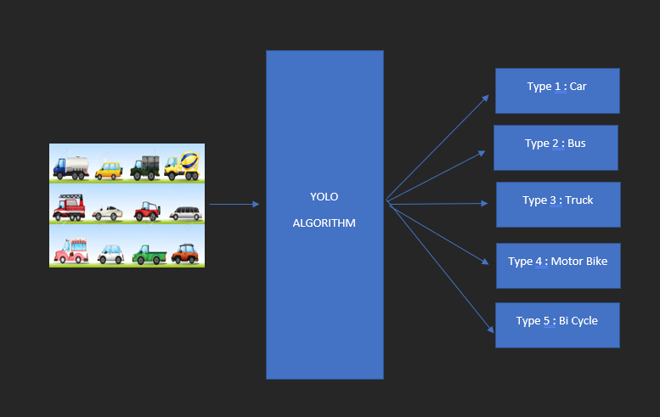
YOLO

Slide 19
Challenges

Slide 20
Challenges
Vehicle classification is a challenging task that requires careful consideration of the various factors that can affect the accuracy of classification.
Variability : Vehicles can come in different shapes, sizes, and colors, which can make it difficult to accurately classify them based on their visual characteristics alone.
Scale variation : Vehicles can appear at different scales, which can affect their visual characteristics and make it difficult to classify them accurately.
Lighting conditions : Lighting conditions can affect the appearance of vehicles, making it challenging to classify them accurately under different lighting conditions.
Class imbalance : Some vehicle classes may be underrepresented in the dataset, which can make it more difficult to train a classifier that performs well on all classes.
Complex backgrounds : Vehicles may appear against complex backgrounds, such as busy streets or natural landscapes, which can make it difficult to isolate the vehicle and accurately classify it.

Slide 21
Conclusion & Future Work

Slide 22
Conclusion
Vehicle classification is an important task that has many applications in transportation, public safety, and other fields. In recent years, there have been significant advances in the use of deep learning algorithms, such as YOLO and Deep SORT, for vehicle classification.
Together, YOLO and Deep SORT can be used to accurately detect and classify vehicles in real-time. However, there are also many challenges associated with vehicle classification, such as variability in appearance, occlusion, and lighting conditions.
Overall, vehicle classification using YOLO and Deep SORT is a promising area of research that has important applications in a variety of fields. Further research and development in this area could lead to significant improvements in transportation safety and efficiency.

Slide 23
Future Work
Multimodal classification : Vehicle classification can be improved by incorporating information from multiple modalities, such as images, videos, and sound.
Transfer learning : Future work could explore the use of transfer learning for vehicle classification, which could reduce the amount of labeled data needed for training and improve performance on underrepresented classes.
Real-time applications : Real-time vehicle classification has important applications in areas such as traffic management and autonomous driving. Future work could focus on developing efficient and accurate methods for real-time vehicle classification.

Slide 24
References

Slide 25
References:
[1] Arinaldi, A., Jaka Arya, P., and Arlan Arventa, G. (2018). “Detection and Classification of Vehicles for Traffic Video Analytics.” INNS Conference on Big Data and Deep Learning, Procedia Computer Science, Bali, Indonesia, 259-268.
[2] Rabin Subedi, Pratik Shrestha, Medha Pujari, Eddie Y. Chou. “Vehicle Classification, Rumble Strips Detection, and Mapping Using Artificial Intelligence” International Conference on Transportation and Development (2022)
[3] Bochkovskiy, A., Wang, C.-Y., and Liao, H.-Y. M. (2020, April 23). “YOLOv4 - Optimal Speed and Accuracy of Object Detection”. <arXiv:2004.10934>(Dec. 1, 2021).

Slide 26
THANK YOU
Any Question?

